Slide 1


Slide 2
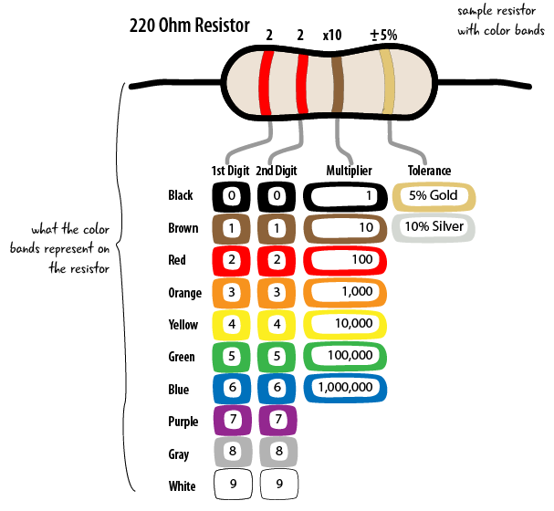
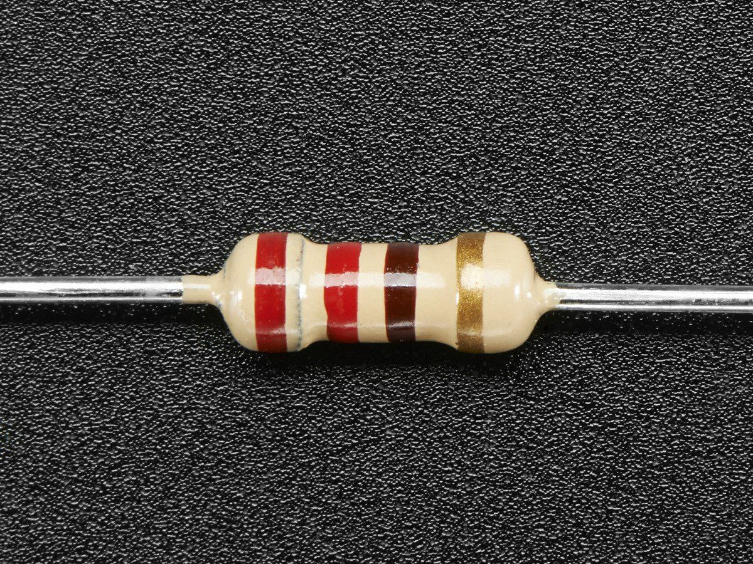
Resistor 220 Ohm

Slide 3
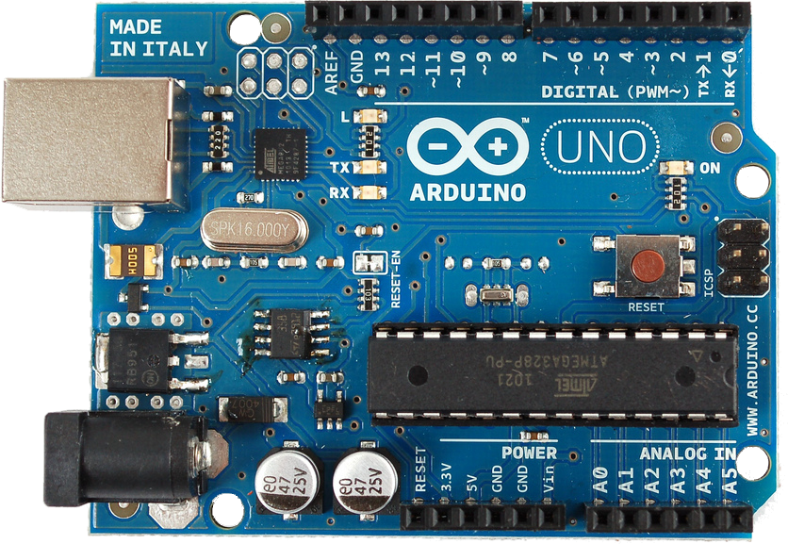
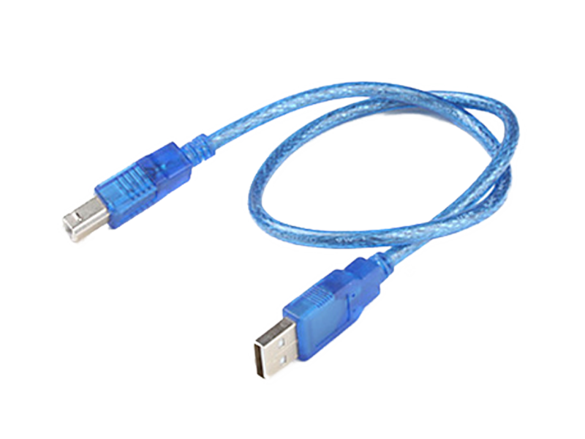
Arduino Uno (Mikrokontroler) + Kabel USB

Slide 4
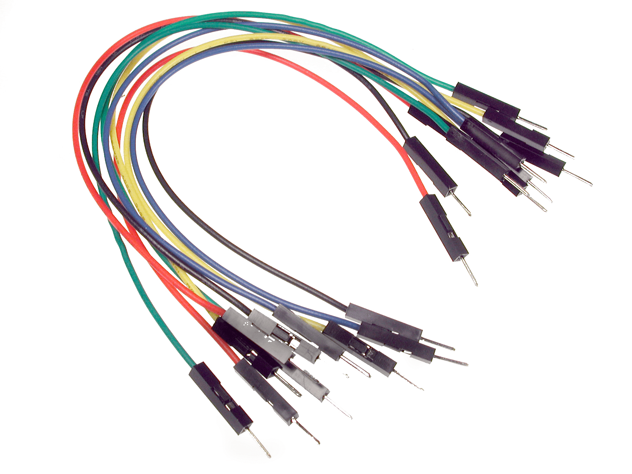
Kabel Jumper Male to Male

Slide 5
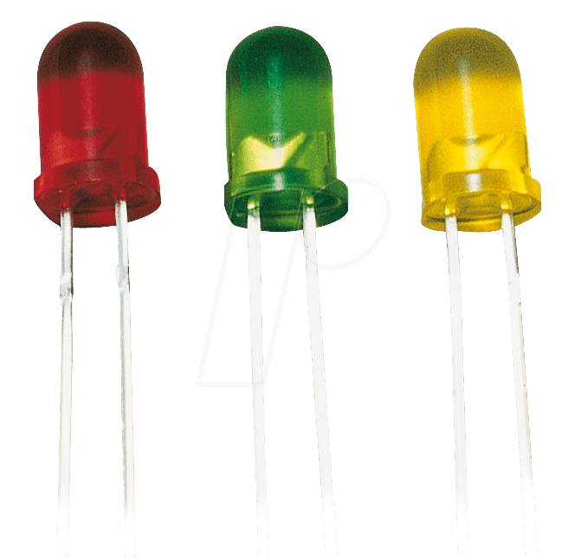
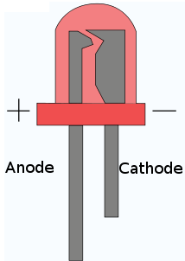
LED/Lampu
Merah
Kuning
Hijau
Merah

Slide 6
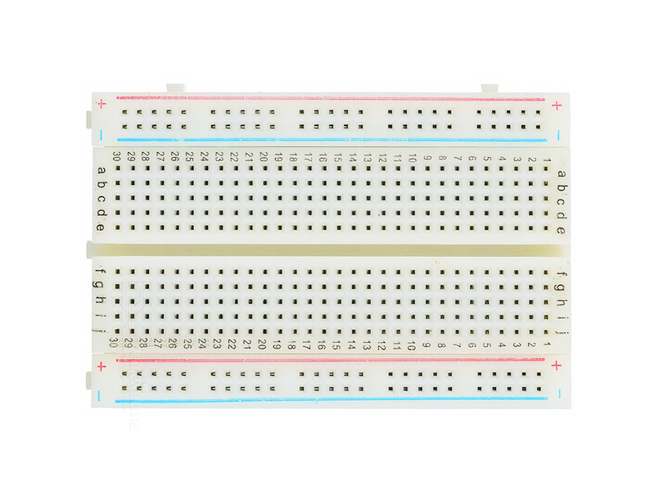
Breadboard
Bagian Atas
Keterangan:
Seri
Paralel
Bagian Tengah
Bagian Bawah

Slide 7
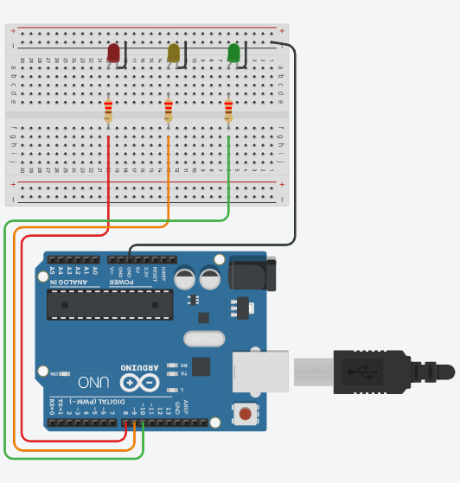
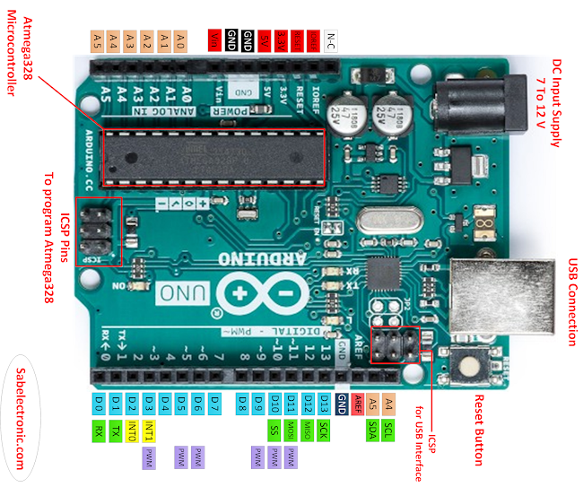
Wiring Diagram
Arduino Uno GPIO | LED Merah | LED Kuning | LED Hijau
8 | + (Positive)
9 |  | + (Positive)
10 |  |  | + (Positive)
GND | - (Negative) | - (Negative) | - (Negative)

Slide 8


